Slide 1
Preliminary Results: u965ms
7/4/2018

Slide 2
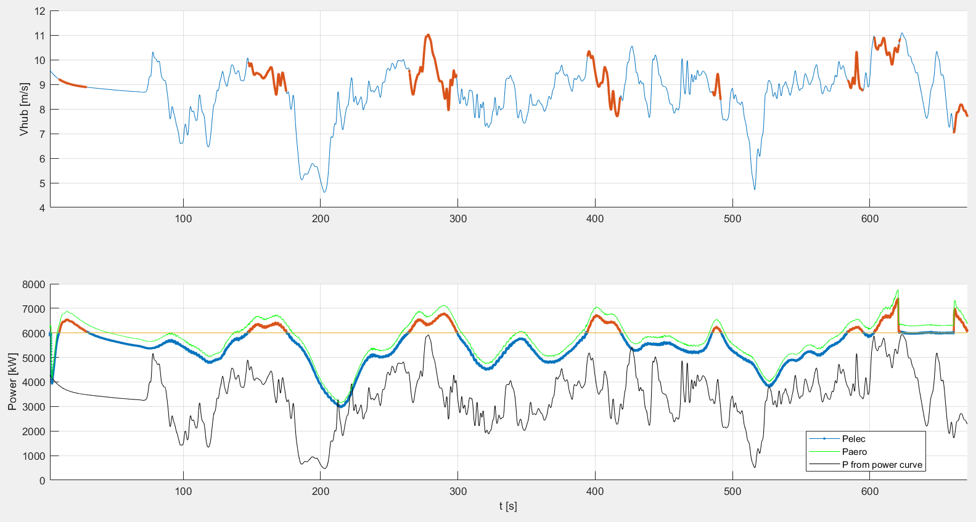

Slide 3
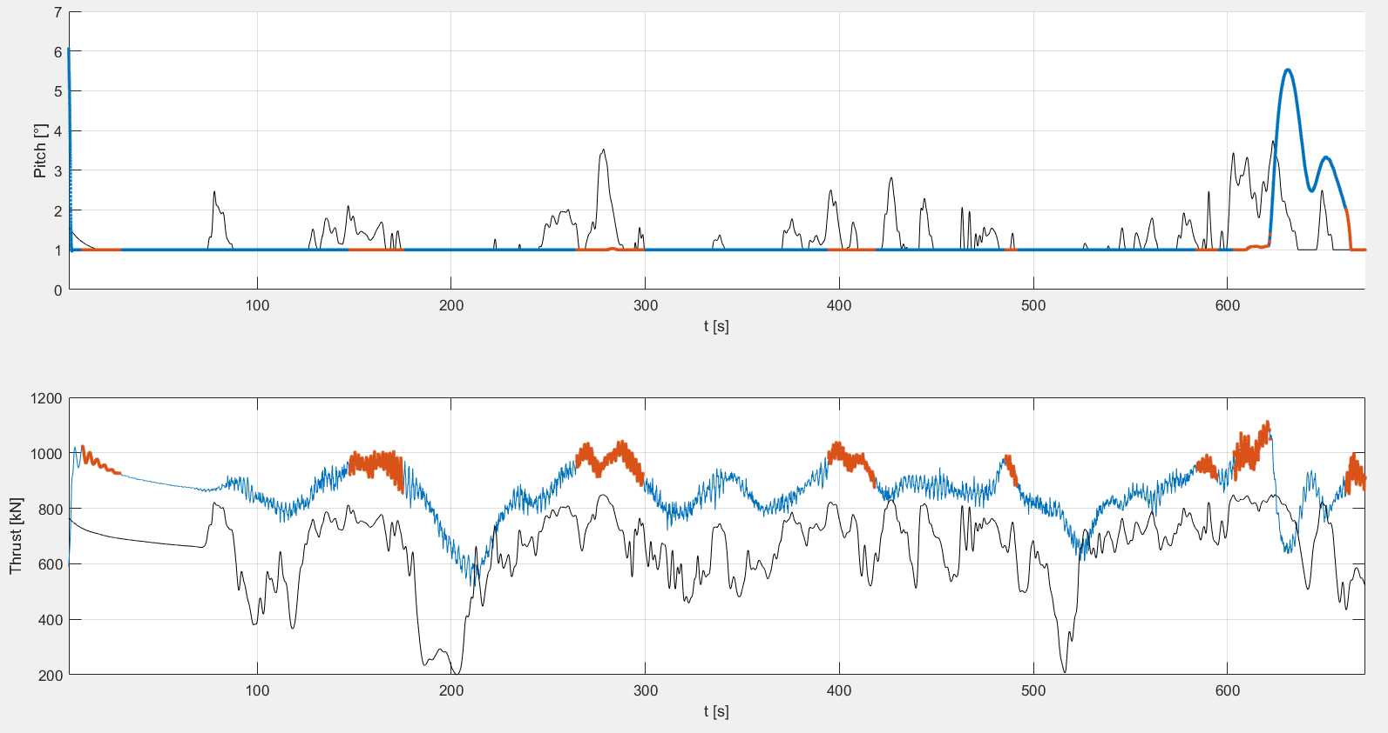

Slide 4
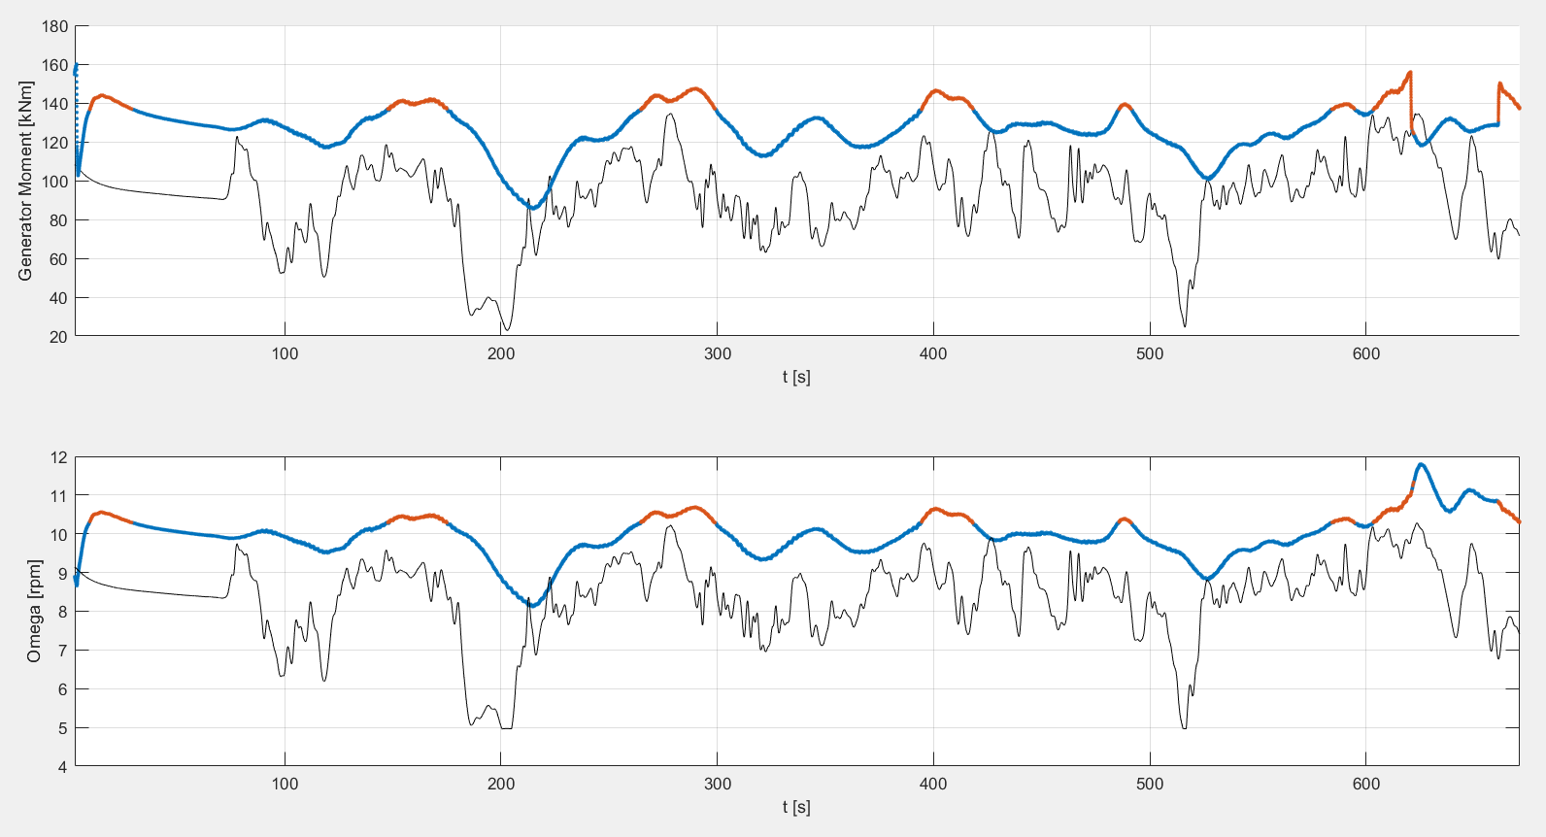

Slide 5
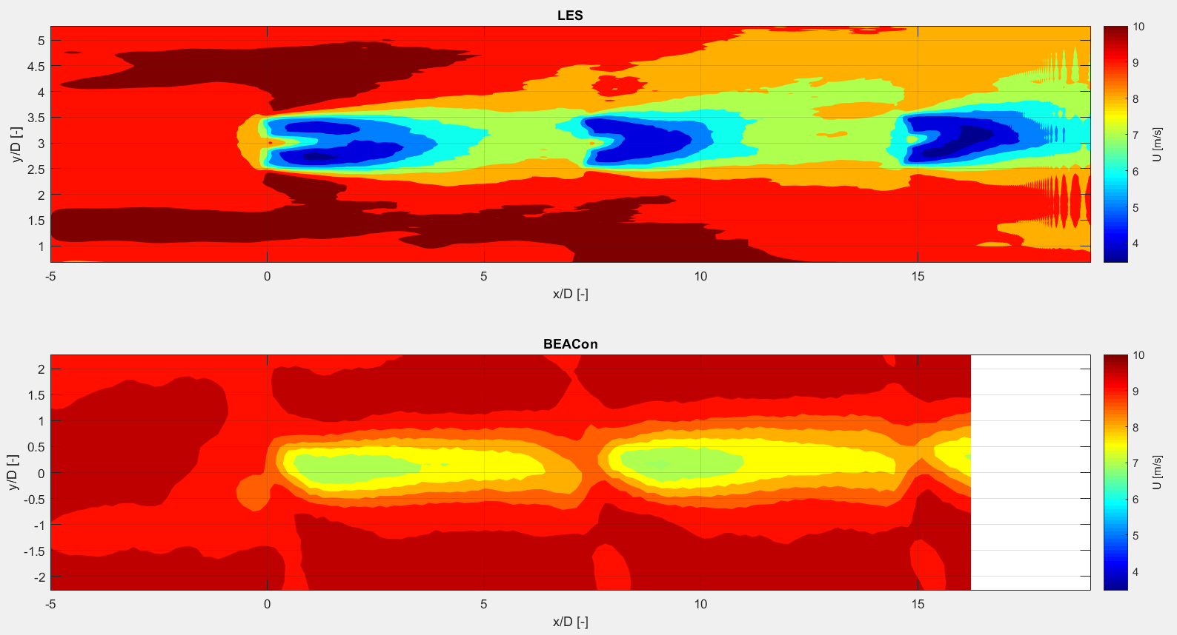
Mean wind speed at 100 m
LES results: total mean of data (not enough data to calculate the ensemble mean)

Slide 6
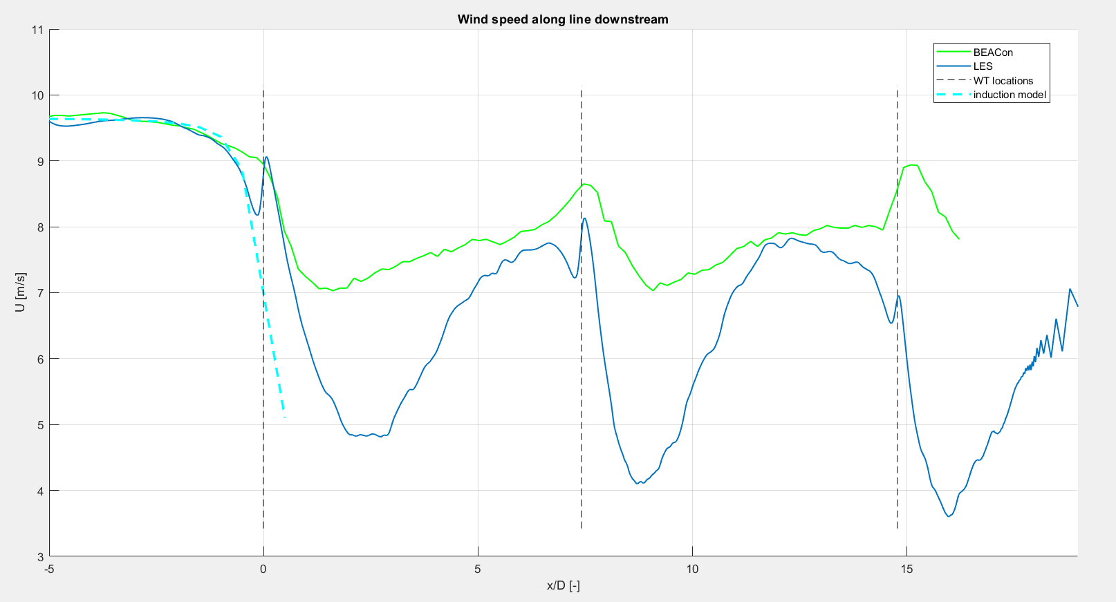
Mean wind speed at 100 m along line in streamwise direction
LES results: total mean of data (not enough data to calculate the ensemble mean)

Slide 7
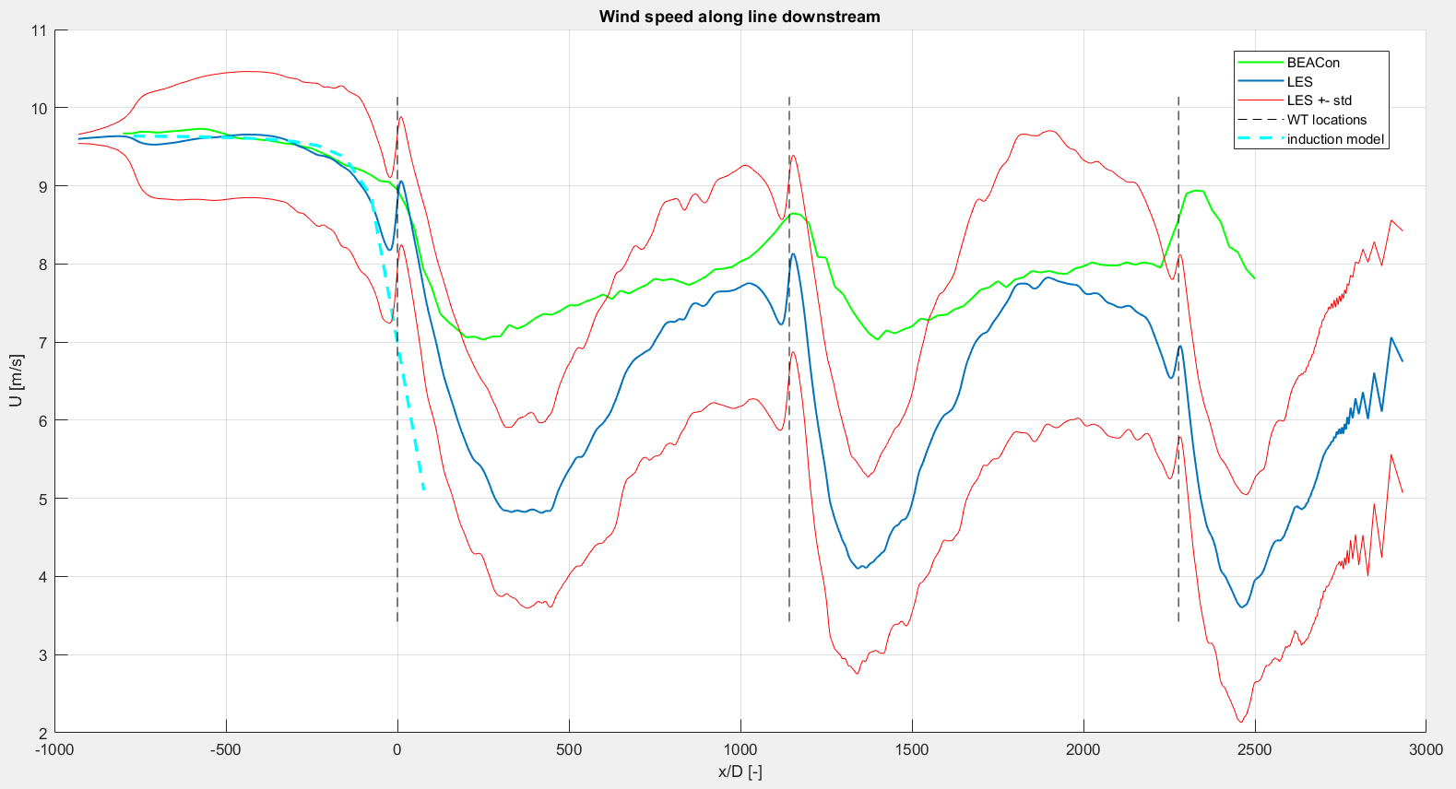
Mean wind speed at 100 m along line in streamwise direction
LES results: total mean of data (not enough data to calculate the ensemble mean)

Slide 8
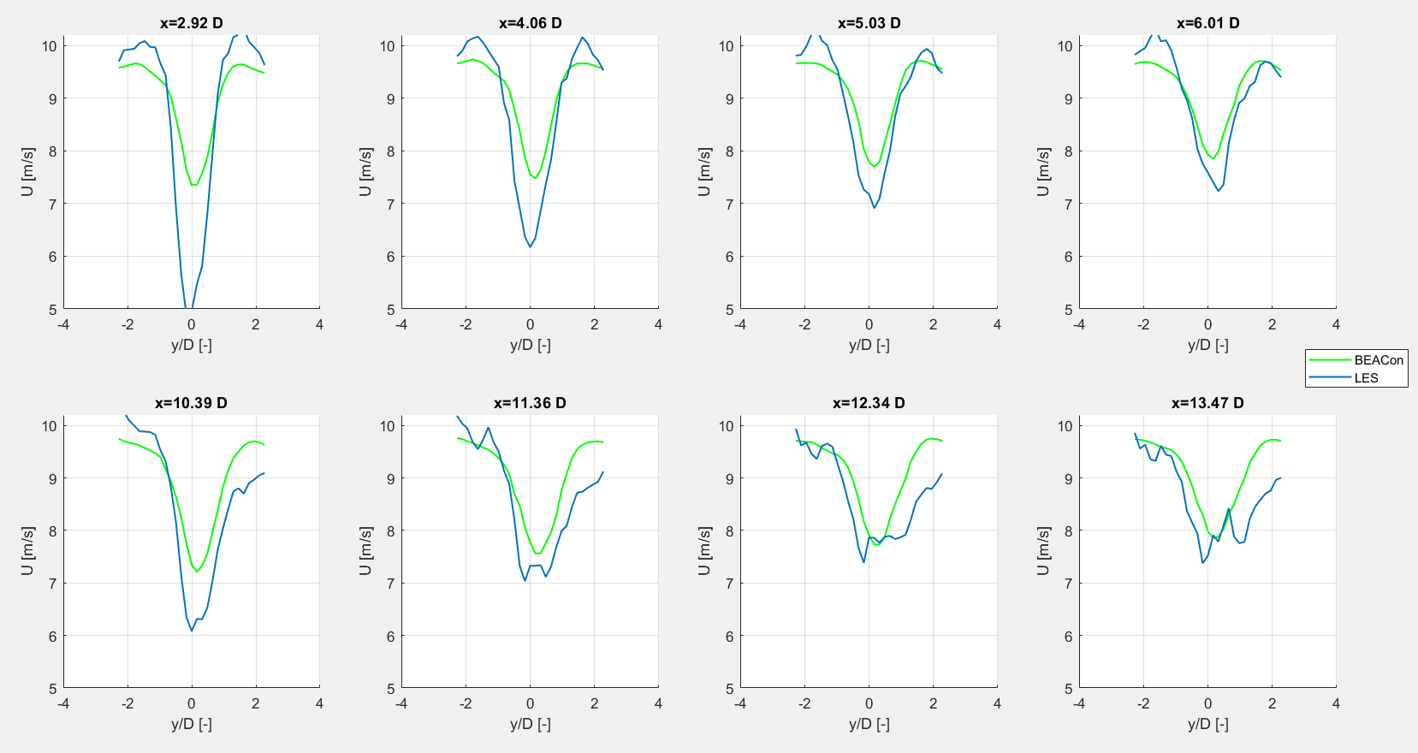
WT1 + ~3,4,5,6 D
WT2 + ~3,4,5,6 D
LES results: total mean of data (not enough data to calculate the ensemble mean)

